Slide 1
FUNDAMENTAL STOCK ANALYSER

Slide 2

Collaborators:- Chetnya Gaba(22BCS15984) Lakshit() Anshu() Simran()

Slide 3
Contents:-
Introduction
Problem Statement
Idea
Software Used
Deliverables
Conclusion

Slide 4

INTRODUCTION
What Are Stocks?
A stock, also known as equity, is a security that represents the ownership of a fraction of the issuing corporation. Units of stock are called "shares" which entitles the owner to a proportion of the corporation's assets and profits.
What Is Stock Analysis?
Stock analysis is the evaluation of a particular trading instrument, an investment sector, or the market as a whole. Stock analysts attempt to determine the future activity of an instrument, sector, or market.
Fundamental Analysis
There are two basic types of stock analysis: fundamental analysis and technical analysis. Fundamental analysis concentrates on data from sources, including financial records, economic reports, company assets, and market share.

Slide 5

PROBLEM STATEMENT
Stock analysis involves comparing a company's current financial statement to its financial statements in previous years to give an investor a sense of whether the company is growing, stable, or deteriorating. After collecting we need analyze that data and convert it in the form so that it can be understood easily. But doing so by a human would be very arduous and with human comes human error which could lead to a big fiasco.

Slide 6

IDEA
If we can make an algorithm which can collect the data required for analysis and convert directly into graphs, tables, etc.
All it should need is to take input the stock by user and it will collect everything via world wide web or any certified space for that data.

Slide 7

Software Used:-VS Code Language:- Python
Visual Studio Code, also commonly referred to as VS Code, is a source-code editor made by Microsoft with the Electron Framework, for Windows, Linux and macOS.
Python is a high-level, general-purpose programming language. Its design philosophy emphasizes code readability with the use of significant indentation.

Slide 8
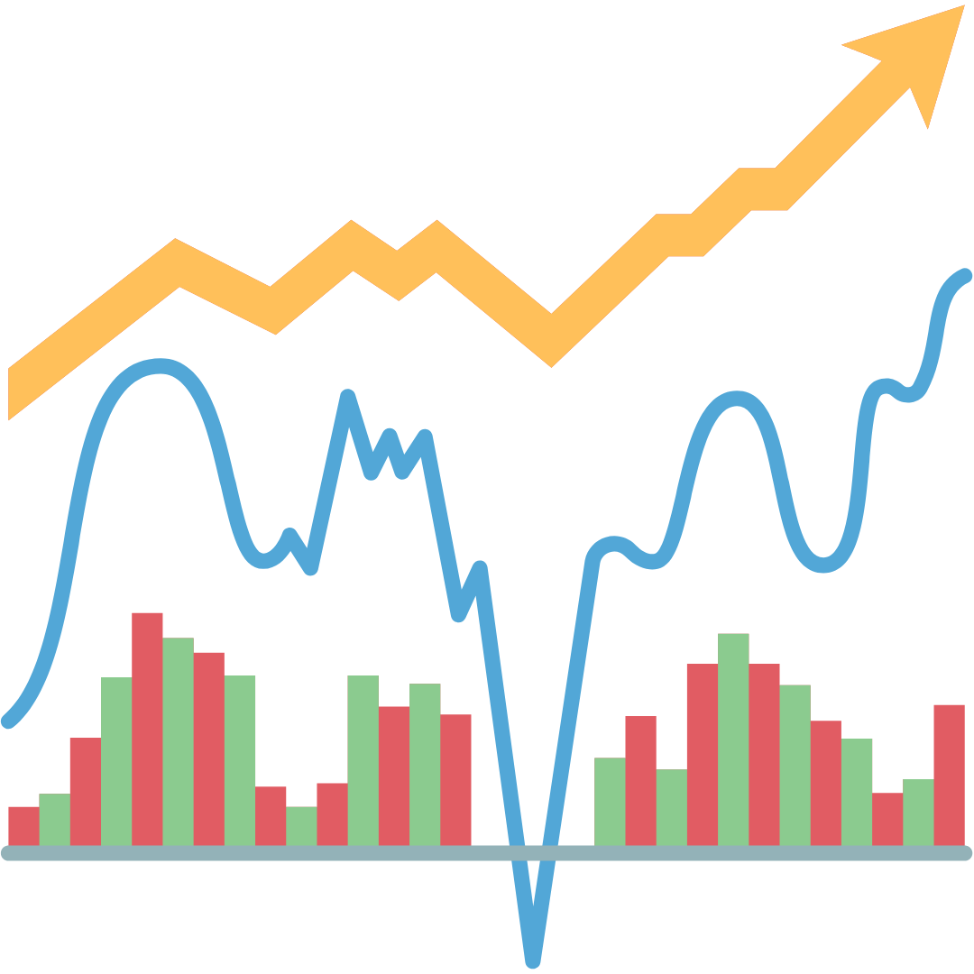
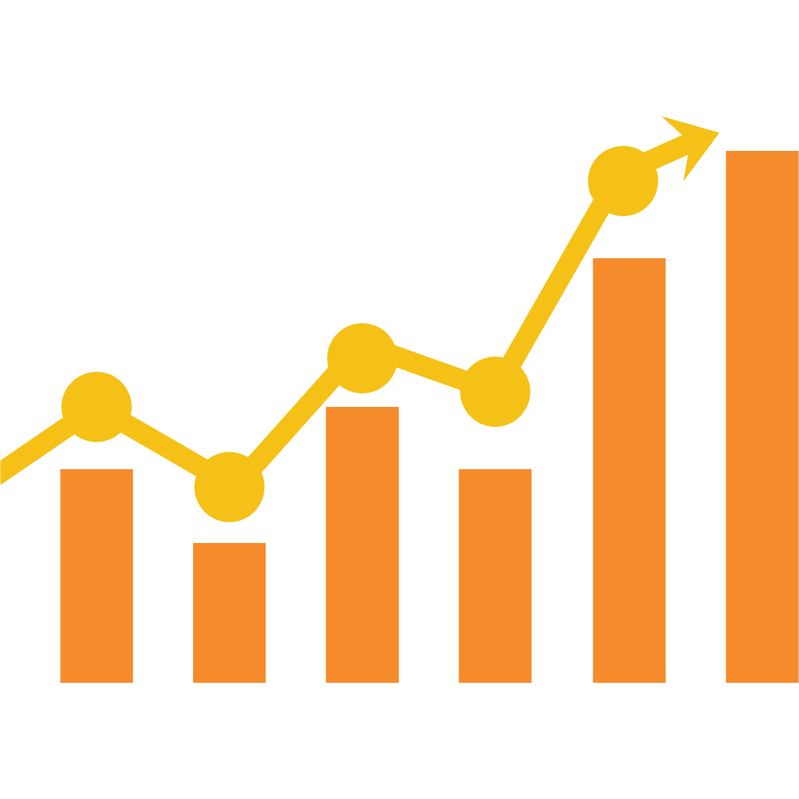
Deliverables
Current Stock Price
All time high-low price of stock.
Quarterly and Yearly Revenue, profit, net worth, etc.
Graphical representation of the data.

Slide 9
CONCLUSION
By providing algorithms for collecting data and stats, scripts to convert data and stats into graphs, tables or clean-cut information we can save a lot of time and invest it into any other productive work.
There’s a lot information required to invest in a stock.
We have reduced the chances of error by a big margin.
Python is very fast and easy to use language.

Slide 10
THANK YOU

